Slide 1
PIZZA HUT ANALYSIS
Presented by Golla Karthik

Slide 2
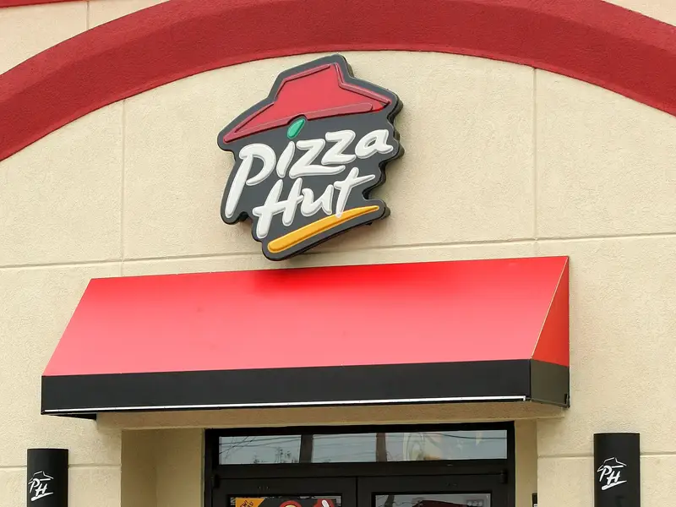
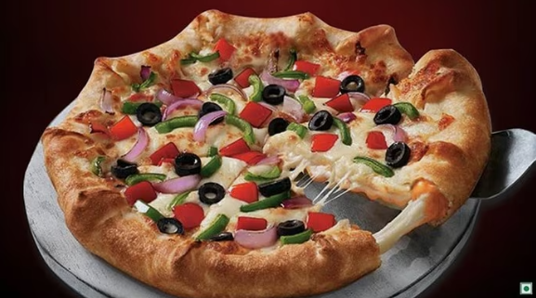
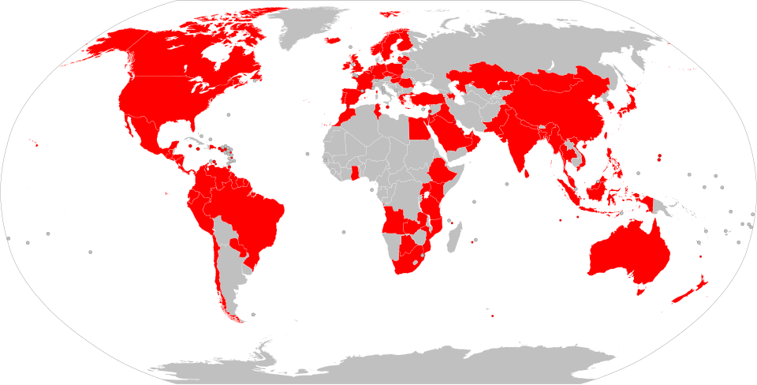
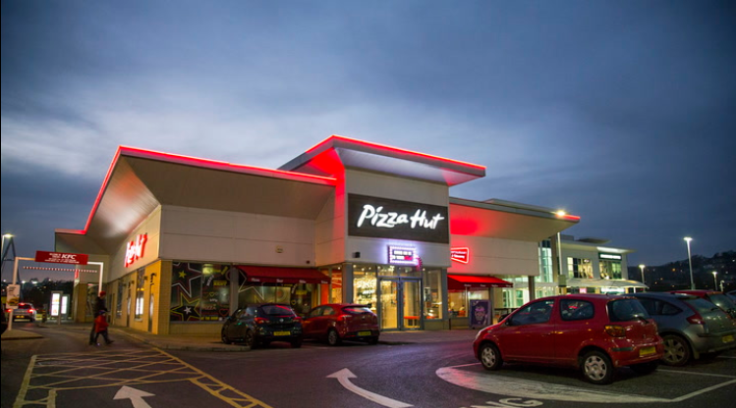
PIZZA-HUT
📖 Company Overview: Founded: 1958 in Wichita, Kansas, USA. Founders: Dan and Frank Carney. Headquarters: Plano, Texas, USA. Industry: Fast Food / Quick Service Restaurant (QSR).
🌍 Global Presence: Over 18,000 restaurants across more than 100 countries. Part of Yum! Brands, alongside KFC and Taco Bell. 🎯 Core Offerings: Wide variety of pizzas, pastas, sides, and desserts. Services include dine-in, takeaway, and home delivery. 🏆 Brand Identity: Known for "The Hut" branding and family-friendly dining experiences. Focus on menu innovation and digital ordering convenience.

Slide 3
Table of Contents
Business Recommendation
Objective & Scope
Analysis & Insights
Data-set Overview
Contents Here
Tools Used
Analysis of the data

Slide 4
Objective & Scope of the Study
Objective
Analyze Pizza Hut data using SQL to uncover order trends, revenue patterns, and category preferences.
Scope
-13 queries spanning Basic to Advanced analysis.
- Business insights & Recommendation for decision making.

Slide 5
Data Set Overview
Orders
Order Details
Pizzas
Pizza Types
Columns in Orders Table
Columns in Order Details Table
Columns in Pizzas Table
Columns in Pizza Types Table
order_id: Unique identifier for each order
date: Date when the order was placed
time: Time when the order was placed
order_details_id: Unique identifier for the detail entry
order_id: Foreign key from orders
pizza_id: Foreign key from pizzas
quantity: Number of pizzas ordered
pizza_id: Unique identifier for a specific pizza variant
pizza_type_id: Foreign key from pizza_types
size: Size of the pizza (S, M, L)
price: Price based on size
pizza_type_id: Unique identifier for a pizza type
name: Pizza name (e.g., “Margherita”)
category: Category like Veggie, Chicken, etc.
ingredients: List of ingredients used

Slide 6
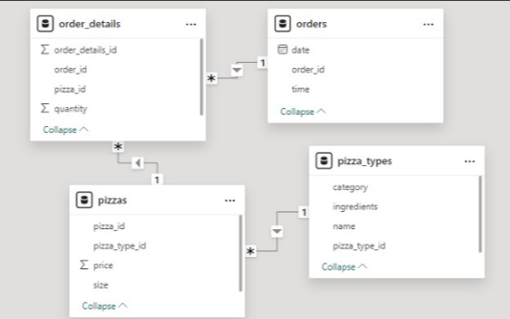
Model View
From Table | To Table | Type | Meaning
orders | order_details | 1 → * | One order can include multiple pizzas
order_details | pizzas | * → 1 | Each entry points to a specific pizza variant
pizzas | pizza_types | * → 1 | Multiple pizza variants belong to a pizza type
Orders
Order_Details
Pizzas
Pizza_types

Slide 7
Tools Used
SQL
Data querying and analysis-
Joins: Used INNER JOINs across 4 tables
Aggregations: COUNT, SUM, AVG
Window Functions: ROW_NUMBER, CUME_SUM
Sorting & Filtering: ORDER BY, LIMIT
Grouping: GROUP BY category, type, date
Subqueries: For average, contribution %
SQL
Case-Study
EXCEL/TABLEAU
Visualization
Vertical Column Chart
Horizontal Bar Chart
Pie Chart
Line Chart
Tree maps
EXCEL/TABLEAU
MS-WORD & POWER POINT
MS-WORD & POWER POINT
Documentation & presentation

Slide 8
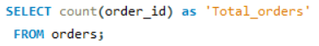
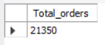
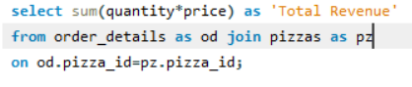
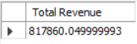
Analysis
Total Orders Count
The Total Orders are 21,350
Total Revenue
Total Revenue generated is 8,17,860.04999

Slide 9
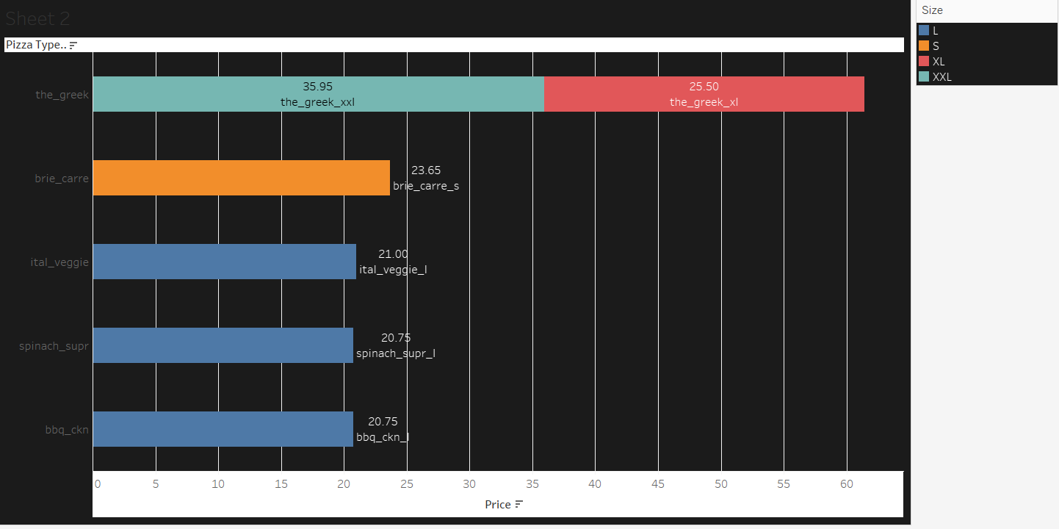
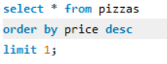
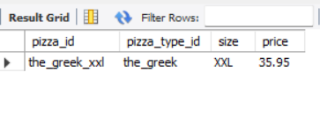
Most Expensive Pizza
The Most expensive pizza is the_Greek_xxl with a price of 35.95
35.95-The Greek_xxl
25.50-The Greek_xl
23.65-brie_carre_s
21-ital_veggie_l
20.75-spinach_supr_l
20.75-bbq_ckn_l

Slide 10
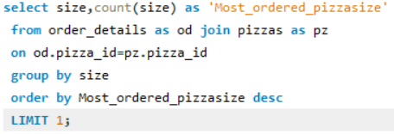
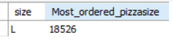
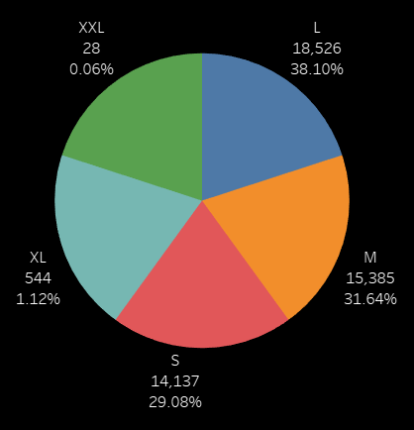
Most Ordered Pizza Size
The Most ordered Size pizza is L with an order quantity of 18526 which accounts for 38.10% of total pizzas.
L
L-SIZE PIZZAS
18526-Contribute to 38.10% of total pizzas
M
M-SIZE PIZZAS
15385-Contribute to 31.64% of total pizzas
S
S-SIZE PIZZAS
14137-Contribute to 29.08% of total pizzas
XL
XL-SIZE PIZZAS
544-Contribute to 1.12 % of total pizzas

Slide 11
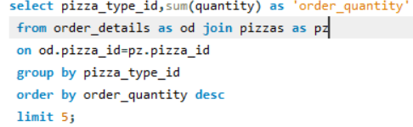
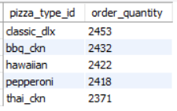
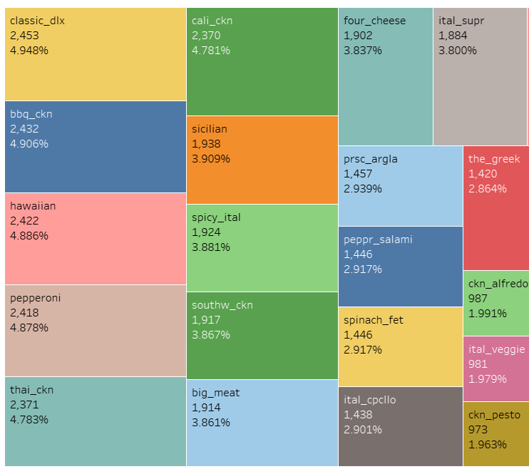
Top 5 Popular Pizzas
Classic_dlx
2453
Bbq_ckn
2432
hawaiian
2422
Thai_ckn
2371

Slide 12
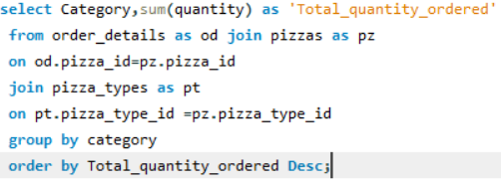
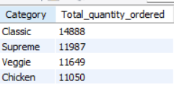
Pizza Quantity by Category
The Most ordered pizza category is Classic with an order quantity of 14888 which accounts for 30% of total pizzas ordered across all categories.
Chicken
11050
11649
14888
Veggie
Classic
11987
Supreme

Slide 13
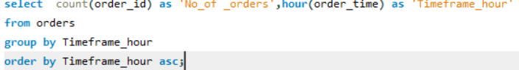
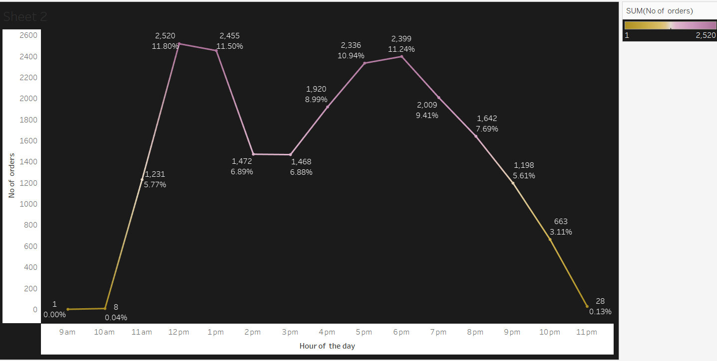
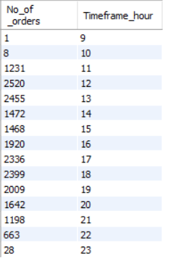
Order Trends by Hour
The Most orders were placed at 12th,13th ,17th
,18th,19th hour of the day and all the orders are above 2000
2520 orders placed at 12th hour of the day which accounts for 11.80% of the Orders Placed
2455 orders placed at 13th hour of the day which accounts for 11.50% of the Orders Placed
2336 orders placed at 17th hour of the day which accounts for 10.94% of the Orders Placed
2399 orders placed at 18th hour of the day which accounts for 11.24% of the Orders Placed
2009 orders placed at 19th hour of the day which accounts for 9.41% of the Orders Placed

Slide 14
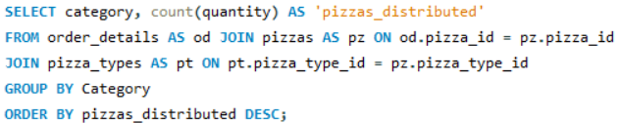
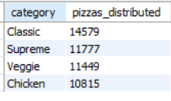
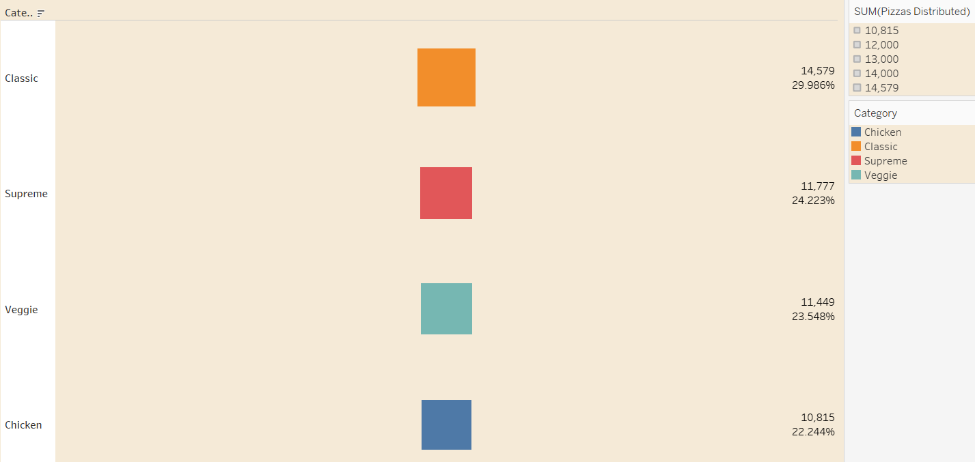
Pizza Distribution by Category
Classic
14579
Supreme
11777
Veggie
11449
Chicken
10815

Slide 15
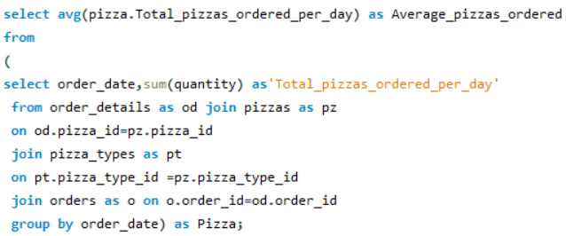
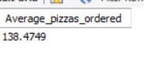
Average Daily Pizzas Ordered

Slide 16
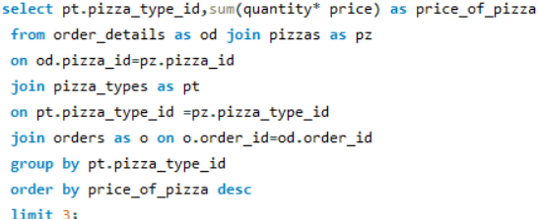
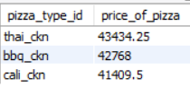
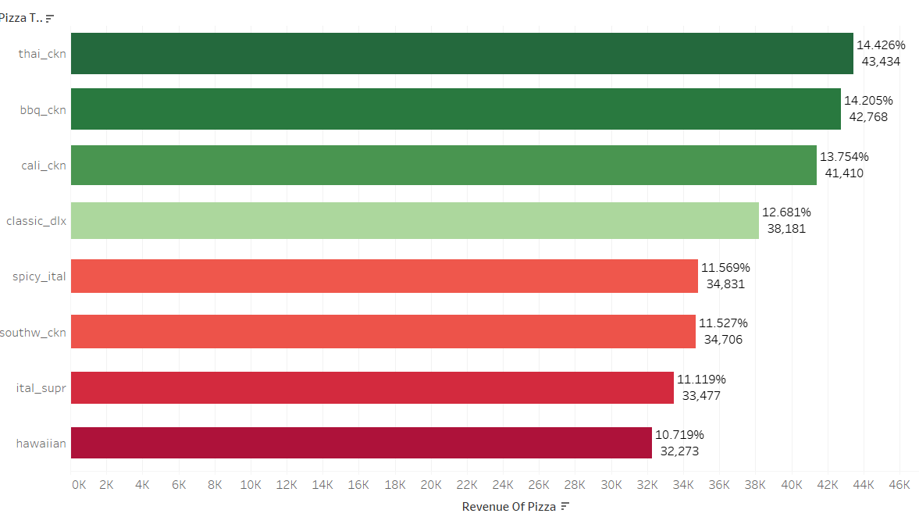
Top 3 Pizza Types by Revenue
The three pizza_types nameky thai_ckn,bbq_ckn,cali_ckn account for 14.426%,14.206% &13.754% of revenue
hawaiian
32273.25
Thai_ckn
43434.25
ital_supr
33476.75
Bbq_ckn
42768.
southw_ckn
34705.75
Cali_ckn
Spicy_ital
41409.5
34831.25
Classic_dlx
38180.5

Slide 17
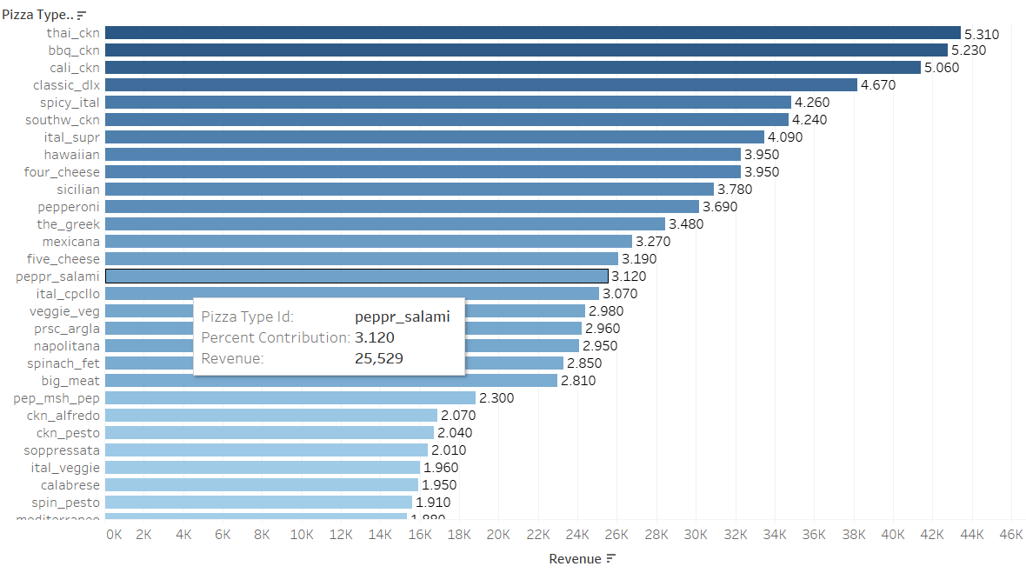
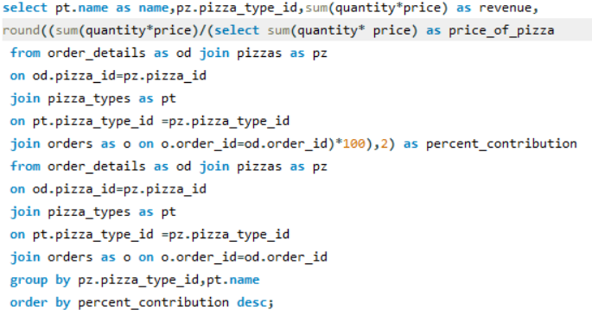
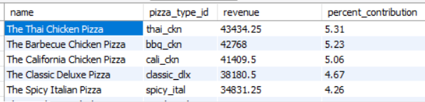
Revenue Contribution by Pizza Types
The Revenue bought by thai chicken pizza, barbecue chicken pizza and California chicken pizza are 43434.25,42768,41409.5 and these are the major contributors and hold about 5.31%,5.23% and 5.06 %of the revenue contribution

Slide 18
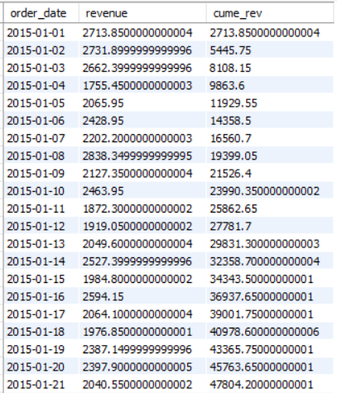
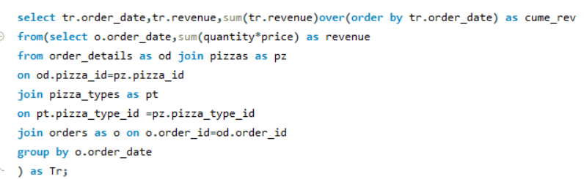
Cumulative Revenue Over Time

Slide 19
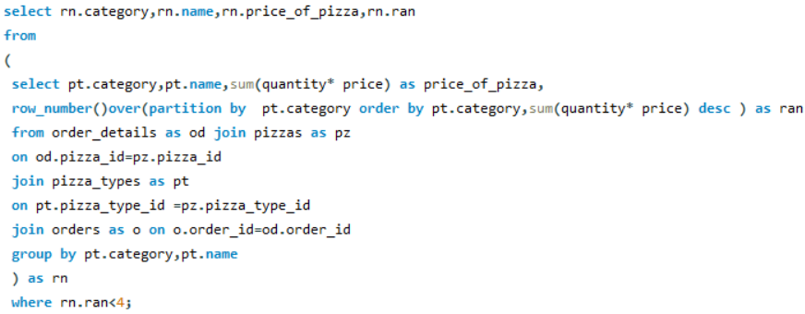
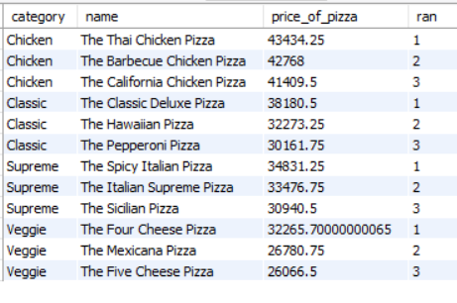
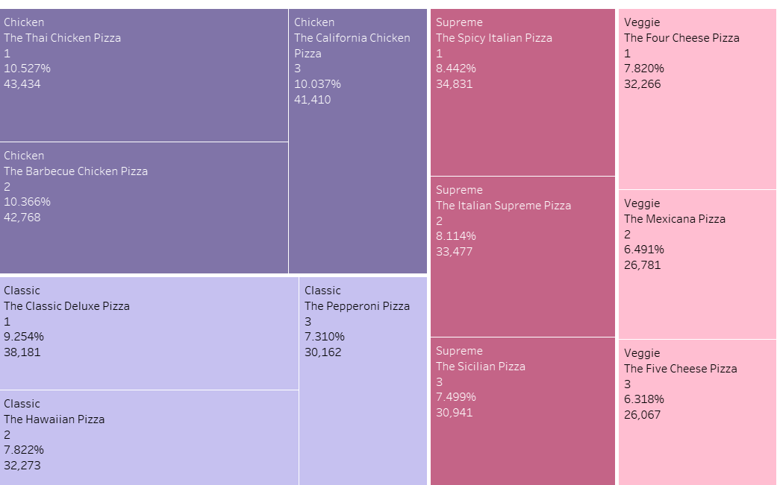
Top 3 Pizza Types by Revenue in each category

Slide 20
Insights & Observations
1.Customer Preferences & Sales Trends Classic (30% of orders, 14,888 pizzas) is the most popular, followed by Supreme, Veggie, and Chicken (least ordered). Customers prefer traditional & familiar flavors over experimental ones.
Chicken category lags behind others – indicating either flavor fatigue or a lack of variety potential for recipe revamp or promotions.
Top Pizzas Classic_dlx (2,453 orders), Bbq_ckn, Hawaiian, and Thai_ckn dominate sales. BBQ and Hawaiian pizzas indicate a preference for sweet-savory flavors.
Size Preference: Large (L) is the most ordered size (38.1%, 18,526 pizzas) followed by M suggesting frequent group/family orders, possibly for sharing..
Premium Pizzas: Greek_xxl (₹35.95) is the most expensive, followed by Greek_xl and brie_carre_s, representing a potential high-margin product segment.
2. Order Timing & Demand Peaks
Peak Hours (Lunch & Dinner): 12 PM (2,520 orders, 11.8%), 1 PM (2,455), 5 PM–7 PM (~2,300–2,400 orders each). Over 50% of daily orders occur in these 5 hours.
Revenue Drivers: Thai_ckn, Bbq_ckn, and Cali_ckn contribute ~42.4% of total revenue (₹43,434 + ₹42,768 + ₹41,410).
3. Revenue & Profitability Total Revenue: ₹8,17,860.05 from 21,350 orders. High-Margin Opportunities: Premium pizzas (Greek_xxl, brie_carre_s) can drive profitability despite lower volume.

Slide 21
Recommendations
1. Menu Optimization & Promotions
Bundle High-Demand Items: Create combos like "Classic_dlx + Drink + Dessert" or "Family XL Pack" to increase order value. Promote Thai_ckn, Bbq_ckn, Cali_ckn (top revenue generators) in featured deals. Revamp Underperforming Categories: Introduce new Chicken pizza flavors or pair with bestsellers (e.g., "Chicken + Classic Combo"). Test limited-time Veggie/Supreme innovations (e.g., spicy or fusion options). Premium Pizza Strategy: Market Greek_xxl as a "gourmet" option for special occasions. Offer upsells (e.g., "Upgrade to Greek_xl for ₹50 more").
2. Peak-Hour Efficiency & Demand Smoothing ⏰ Staffing & Operations: Pre-prep dough/toppings before 12 PM & 5 PM rushes to reduce wait times. Prioritize delivery fleets during peak hours (12–1 PM, 6–7 PM). 🎯 Time-Based Promotions: "Early Dinner Discount" (5–5:30 PM) to shift demand and reduce 6 PM overload. "Late-Night Special" post-9 PM to boost off-peak sales.
3. Data-Driven Growth Strategies 📢 Loyalty & Retention: Reward frequent buyers with points for top pizzas (e.g., "Order Classic_dlx 3x, get 1 free"). Push notifications at usual order times (e.g., "Your favorite Bbq_ckn is 10% off at 6 PM!").
4. Operational Improvements 🛒 Inventory & Waste Reduction: Stock more Large (L) bases and Classic/Supreme toppings to match demand. Reduce low-selling ingredients (e.g., niche Chicken variants). 📝 Customer Feedback Loop: Survey customers on Chicken pizza preferences to improve recipes. Test smaller sizes for premium pizzas (e.g., Greek_s) to attract solo buyers.

Slide 22
THANK YOU

Slide 23




GOLLA KARTHIK

